Slide 1
Chapter 2
Intelligent Agents

Slide 2

Chapter 2
Intelligent Agents
What is an agent ?
  An agent is anything that perceiving its environment through sensors and acting upon that environment through actuators
  Example:
    Human is an agent
    A robot is also an agent with cameras and motors
    A thermostat detecting room temperature.

Slide 3
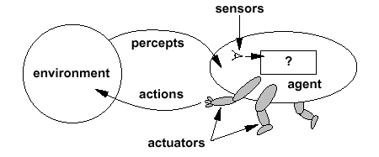
Intelligent Agents

Slide 4
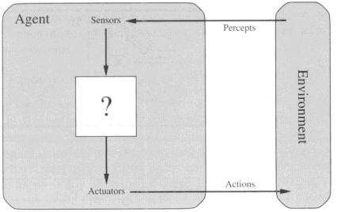
Diagram of an agent
What AI should fill

Slide 5
Simple Terms
Percept
  Agent’s perceptual inputs at any given instant
Percept sequence
  Complete history of everything that the agent has ever perceived.

Slide 6
Agent function & program
Agent’s behavior is mathematically described by
  Agent function
  A function mapping any given percept sequence to an action
Practically it is described by
  An agent program
  The real implementation

Slide 7
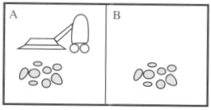
Vacuum-cleaner world
Perception: Clean or Dirty? where it is in?
Actions: Move left, Move right, suck, do nothing

Slide 8
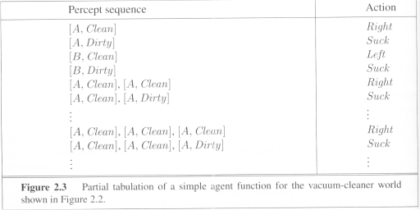
Vacuum-cleaner world

Slide 9
Program implements the agent function tabulated in Fig. 2.3
Function Reflex-Vacuum-Agent([location,status]) return an action
If status = Dirty then return Suck
else if location = A then return Right
else if location = B then return left

Slide 10
Concept of Rationality
Rational agent
  One that does the right thing
  = every entry in the table for the agent function is correct (rational).
What is correct?
  The actions that cause the agent to be most successful
  So we need ways to measure success.

Slide 11
Performance measure
Performance measure
  An objective function that determines
    How the agent does successfully
    E.g., 90% or 30% ?
An agent, based on its percepts
  → action sequence :
  if desirable, it is said to be performing well.
  No universal performance measure for all agents

Slide 12
Performance measure
A general rule:
  Design performance measures according to
    What one actually wants in the environment
    Rather than how one thinks the agent should behave
E.g., in vacuum-cleaner world
  We want the floor clean, no matter how the agent behave
  We don’t restrict how the agent behaves

Slide 13
Rationality
What is rational at any given time depends on four things:
  The performance measure defining the criterion of success
  The agent’s prior knowledge of the environment
  The actions that the agent can perform
  The agents’s percept sequence up to now

Slide 14
Rational agent
For each possible percept sequence,
  an rational agent should select
    an action expected to maximize its performance measure, given the evidence provided by the percept sequence and whatever built-in knowledge the agent has
E.g., an exam
  Maximize marks, based on
  the questions on the paper & your knowledge

Slide 15
Example of a rational agent
Performance measure
  Awards one point for each clean square
    at each time step, over 10000 time steps
Prior knowledge about the environment
  The geography of the environment
  Only two squares
  The effect of the actions

Slide 16
Example of a rational agent
Actions that can perform
  Left, Right, Suck and NoOp
Percept sequences
  Where is the agent?
  Whether the location contains dirt?
Under this circumstance, the agent is rational.

Slide 17
Omniscience
An omniscient agent
  Knows the actual outcome of its actions in advance
  No other possible outcomes
  However, impossible in real world
An example
  crossing a street but died of the fallen cargo door from 33,000ft → irrational?

Slide 18
Omniscience
Based on the circumstance, it is rational.
As rationality maximizes
  Expected performance
Perfection maximizes
  Actual performance
Hence rational agents are not omniscient.

Slide 19
Learning
Does a rational agent depend on only current percept?
  No, the past percept sequence should also be used
  This is called learning
  After experiencing an episode, the agent
    should adjust its behaviors to perform better for the same job next time.

Slide 20
Autonomy
If an agent just relies on the prior knowledge of its designer rather than its own percepts then the agent lacks autonomy
A rational agent should be autonomous- it should learn what it can to compensate for partial or incorrect prior knowledge.
E.g., a clock
  No input (percepts)
  Run only but its own algorithm (prior knowledge)
  No learning, no experience, etc.

Slide 21
Software Agents
Sometimes, the environment may not be the real world
  E.g., flight simulator, video games, Internet
  They are all artificial but very complex environments
  Those agents working in these environments are called
    Software agent (softbots)
    Because all parts of the agent are software

Slide 22
Task environments
Task environments are the problems
  While the rational agents are the solutions
Specifying the task environment
  PEAS description as fully as possible
    Performance
    Environment
    Actuators
    Sensors
    In designing an agent, the first step must always be to specify the task environment as fully as possible.
Use automated taxi driver as an example

Slide 23
Task environments
Performance measure
  How can we judge the automated driver?
  Which factors are considered?
    getting to the correct destination
    minimizing fuel consumption
    minimizing the trip time and/or cost
    minimizing the violations of traffic laws
    maximizing the safety and comfort, etc.

Slide 24
Task environments
Environment
  A taxi must deal with a variety of roads
  Traffic lights, other vehicles, pedestrians, stray animals, road works, police cars, etc.
  Interact with the customer

Slide 25
Task environments
Actuators (for outputs)
  Control over the accelerator, steering, gear shifting and braking
  A display to communicate with the customers
Sensors (for inputs)
  Detect other vehicles, road situations
  GPS (Global Positioning System) to know where the taxi is
  Many more devices are necessary

Slide 26
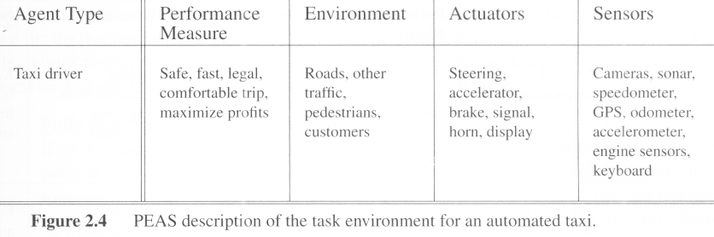
Task environments
A sketch of automated taxi driver

Slide 27
Properties of task environments
Fully observable vs. Partially observable
  If an agent’s sensors give it access to the complete state of the environment at each point in time then the environment is effectively and fully observable
    if the sensors detect all aspects
    That are relevant to the choice of action

Slide 28
Partially observable
An environment might be Partially observable because of noisy and inaccurate sensors or because parts of the state are simply missing from the sensor data.
Example:
  A local dirt sensor of the cleaner cannot tell
  Whether other squares are clean or not

Slide 29
Properties of task environments
Deterministic vs. stochastic
  next state of the environment Completely determined by the current state and the actions executed by the agent, then the environment is deterministic, otherwise, it is Stochastic.
  Strategic environment: deterministic except for actions of other agents
  -Cleaner and taxi driver are:
    Stochastic because of some unobservable aspects → noise or unknown

Slide 30
Properties of task environments
Episodic vs. sequential
  An episode = agent’s single pair of perception & action
  The quality of the agent’s action does not depend on other episodes
    Every episode is independent of each other
  Episodic environment is simpler
    The agent does not need to think ahead
Sequential
  Current action may affect all future decisions
  -Ex. Taxi driving and chess.

Slide 31
Properties of task environments
Static vs. dynamic
  A dynamic environment is always changing over time
    E.g., the number of people in the street
  While static environment
    E.g., the destination
Semidynamic
  environment is not changed over time
  but the agent’s performance score does

Slide 32
Properties of task environments
Discrete vs. continuous
  If there are a limited number of distinct states, clearly defined percepts and actions, the environment is discrete
  E.g., Chess game
  Continuous: Taxi driving

Slide 33
Properties of task environments
Single agent VS. multiagent
  Playing a crossword puzzle – single agent
  Chess playing – two agents
  Competitive multiagent environment
    Chess playing
  Cooperative multiagent environment
    Automated taxi driver
    Avoiding collision

Slide 34
Properties of task environments
Known vs. unknown
This distinction refers not to the environment itslef but to the agent’s (or designer’s) state of knowledge about the environment.
-In known environment, the outcomes for all actions are
given. ( example: solitaire card games).
- If the environment is unknown, the agent will have to learn how it works in order to make good decisions.( example: new video game).

Slide 35
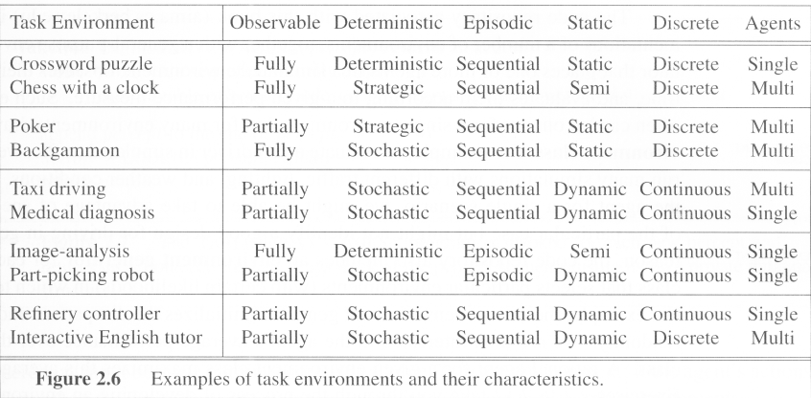
Examples of task environments

Slide 36
Structure of agents

Slide 37
Structure of agents
Agent = architecture + program
  Architecture = some sort of computing device (sensors + actuators)
  (Agent) Program = some function that implements the agent mapping = “?”
  Agent Program = Job of AI

Slide 38
Agent programs
Input for Agent Program
  Only the current percept
Input for Agent Function
  The entire percept sequence
  The agent must remember all of them
Implement the agent program as
  A look up table (agent function)

Slide 39
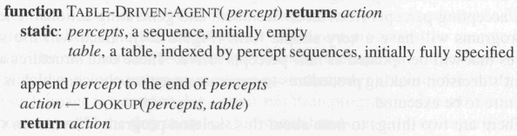
Agent programs
Skeleton design of an agent program

Slide 40
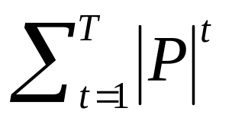
Agent Programs
P = the set of possible percepts
T= lifetime of the agent
  The total number of percepts it receives
Size of the look up table
Consider playing chess
  P =10, T=150
  Will require a table of at least 10¹⁵⁰ entries

Slide 41
Agent programs
Despite of huge size, look up table does what we want.
The key challenge of AI
  Find out how to write programs that, to the extent possible, produce rational behavior
    From a small amount of code
    Rather than a large amount of table entries
  E.g., a five-line program of Newton’s Method
  V.s. huge tables of square roots, sine, cosine, …

Slide 42
Types of agent programs
Four types
  Simple reflex agents
  Model-based reflex agents
  Goal-based agents
  Utility-based agents

Slide 43
Simple reflex agents
It uses just condition-action rules
  The rules are like the form “if … then …”
  efficient but have narrow range of applicability
  Because knowledge sometimes cannot be stated explicitly
  Work only
    if the environment is fully observable

Slide 44
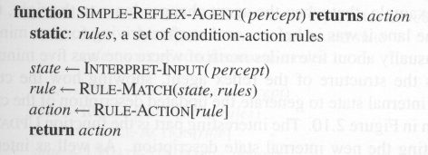
Simple reflex agents

Slide 45
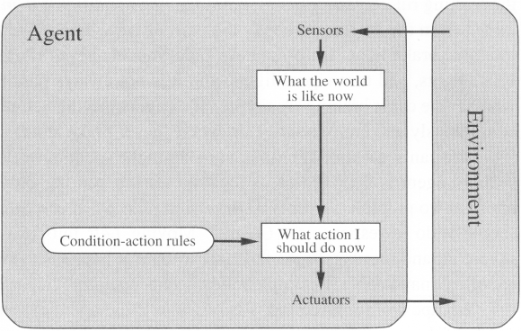
Simple reflex agents (2)

Slide 46

A Simple Reflex Agent in Nature
percepts
(size, motion)
RULES:
(1) If small moving object,
then activate SNAP
(2) If large moving object,
then activate AVOID and inhibit SNAP
ELSE (not moving) then NOOP
needed for
completeness
Action: SNAP or AVOID or NOOP

Slide 47
Model-based Reflex Agents
For the world that is partially observable
  the agent has to keep track of an internal state
    That depends on the percept history
    Reflecting some of the unobserved aspects
    E.g., driving a car and changing lane
Requiring two types of knowledge
  How the world evolves independently of the agent
  How the agent’s actions affect the world

Slide 48
Example Table Agent
With Internal State
IF
THEN
Saw an object ahead, and turned right, and it’s now clear ahead | Go straight
Saw an object Ahead, turned right, and object ahead again | Halt
See no objects ahead | Go straight
See an object ahead | Turn randomly

Slide 49
Example Reflex Agent With Internal State:
Wall-Following
start
Actions: left, right, straight, open-door
Rules:
If open(left) & open(right) and open(straight) then
choose randomly between right and left
If wall(left) and open(right) and open(straight) then straight
If wall(right) and open(left) and open(straight) then straight
If wall(right) and open(left) and wall(straight) then left
If wall(left) and open(right) and wall(straight) then right
If wall(left) and door(right) and wall(straight) then open-door
If wall(right) and wall(left) and open(straight) then straight.
(Default) Move randomly

Slide 50
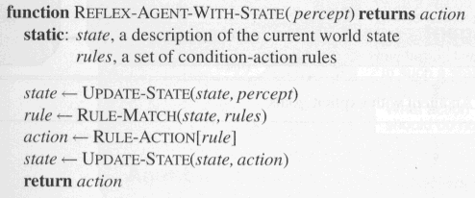
Model-based Reflex Agents
The agent is with memory

Slide 51
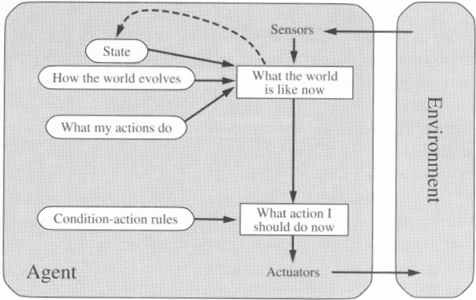
Model-based Reflex Agents

Slide 52
Goal-based agents
Current state of the environment is always not enough
The goal is another issue to achieve
  Judgment of rationality / correctness
Actions chosen → goals, based on
  the current state
  the current percept

Slide 53
Goal-based agents
Conclusion
  Goal-based agents are less efficient
  but more flexible
    Agent ← Different goals ← different tasks
  Search and planning
    two other sub-fields in AI
    to find out the action sequences to achieve its goal

Slide 54
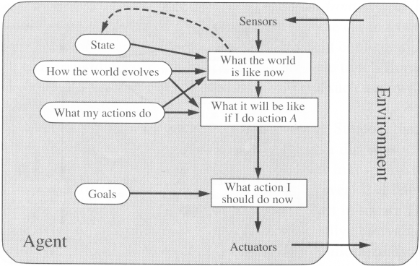
Goal-based agents

Slide 55
Utility-based agents
Goals alone are not enough
  to generate high-quality behavior
  E.g. meals in Canteen, good or not ?
Many action sequences → the goals
  some are better and some worse
  If goal means success,
  then utility means the degree of success (how successful it is)

Slide 56
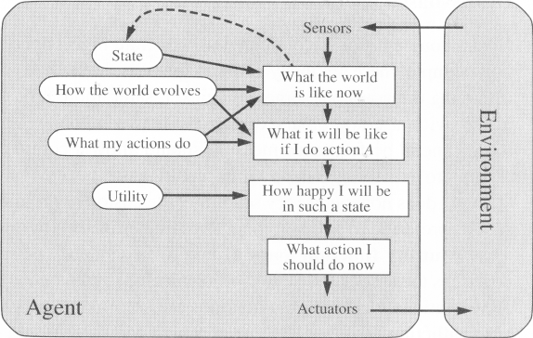
Utility-based agents (4)

Slide 57
Utility-based agents
it is said state A has higher utility
  If state A is more preferred than others
Utility is therefore a function
  that maps a state onto a real number
  the degree of success

Slide 58
Utility-based agents (3)
Utility has several advantages:
  When there are conflicting goals,
    Only some of the goals but not all can be achieved
    utility describes the appropriate trade-off
  When there are several goals
    None of them are achieved certainly
    utility provides a way for the decision-making

Slide 59
Learning Agents
After an agent is programmed, can it work immediately?
  No, it still need teaching
In AI,
  Once an agent is done
  We teach it by giving it a set of examples
  Test it by using another set of examples
We then say the agent learns
  A learning agent

Slide 60
Learning Agents
Four conceptual components
  Learning element
    Making improvement
  Performance element
    Selecting external actions
  Critic
    Tells the Learning element how well the agent is doing with respect to fixed performance standard.
    (Feedback from user or examples, good or not?)
  Problem generator
    Suggest actions that will lead to new and informative experiences.

Slide 61
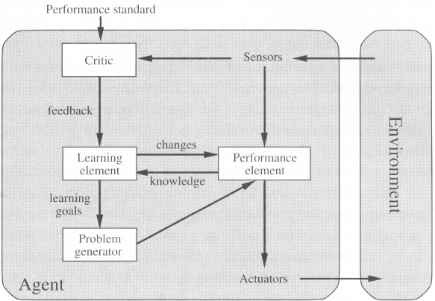
Learning Agents

